Slide 1
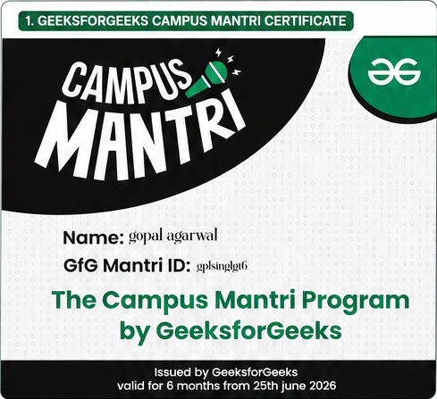
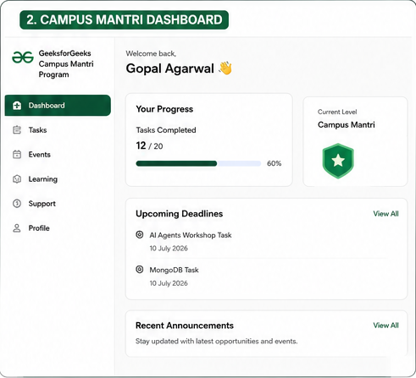
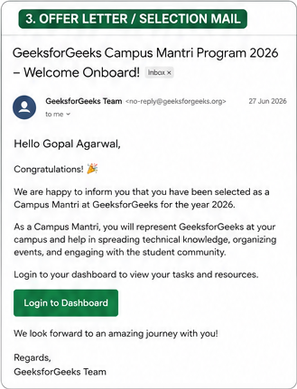
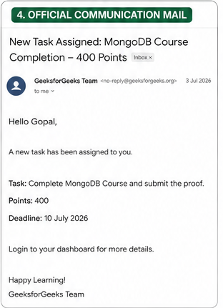
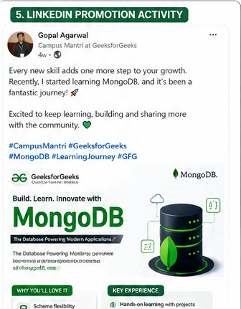
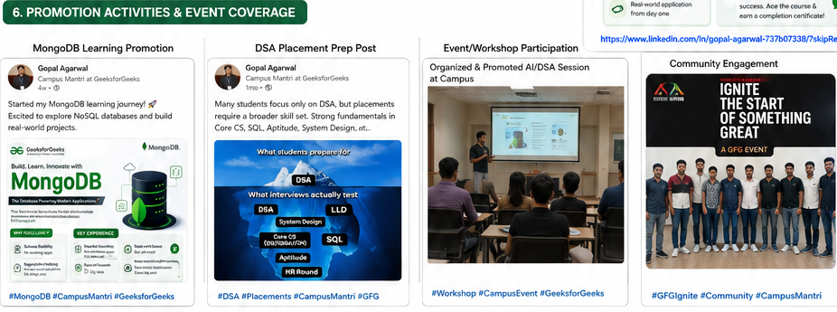

INTERNSHIP EVIDENCE & ACHIEVEMENTS
CAMPUS MANTRI • 2026
Selected as GeeksforGeeks Campus Mantri – 2026
OFFICIAL PROOF & COMMUNICATION
ACTIVITIES & PARTICIPATION
CERTIFICATE
DASHBOARD
KEY EVIDENCE
• Official welcome / selection mail
• Task assignment communication
• LinkedIn promotion
• MongoDB & DSA promotion
• Technical event / workshop
• GFG Ignite community activity
WELCOME MAIL
TASK ASSIGNMENT
LINKEDIN
ACTIVITIES / EVENT
GFG IGNITE
Evidence reflects participation, communication, promotion, technical engagement and community activities completed during the internship.

